Slide 1

Queue Data structure
Course Instructor:
Inayat-ur-Rehman, PhD
COMSATS University, Islamabad

Slide 2

Words of wisdom

Slide 3
Overview
Topics Covered
What is Queue (FIFO)?
Stack vs Queue?
Operations of Queue (Enqueue, Dequeue)
What is Circular Queue (FIFO)?
Operations of Circular Queue
Review of Last Topic : STACK

Slide 4
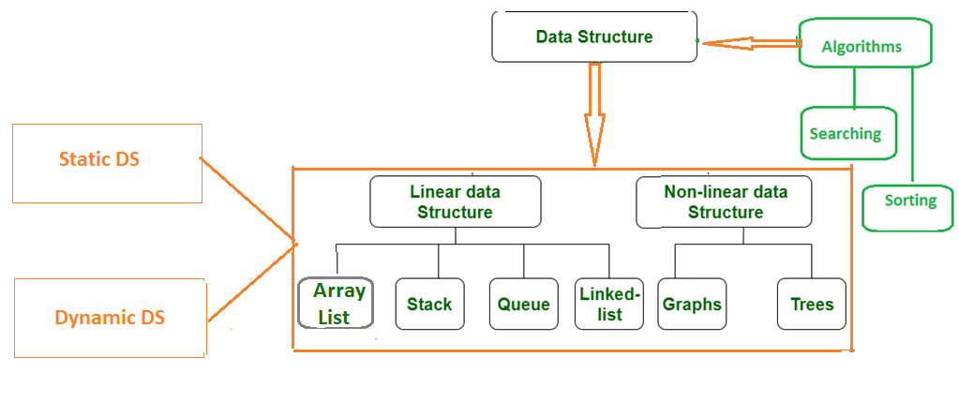
Topics covered

Slide 5
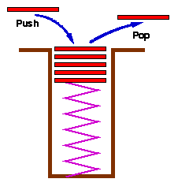
Review of last topic (Stack)
A stack is used to store elements where the Last element In is the First one Out (LIFO).
Common operations are:
Push()
Pop()
Is_empty()
Is_full()
Top()

Slide 6
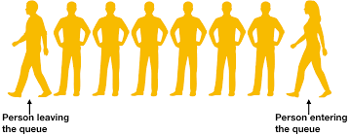
What is queue?
Definition:
Queue is an Abstract data structure that follow the First In First Out (FIFO) i.e. the first element that is entered in the queue is the first one to be served.
Daily life example:
a line of people waiting for their turn at a bank or
a line of vehicles waiting for token at a tool plaza or
a line of customers at cash and carry to pay their bills.
Dequeue()
Equeue()
Reference: codesdope.com

Slide 7

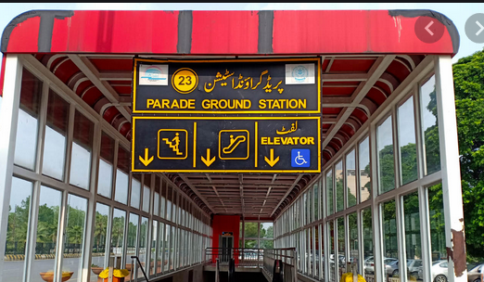



QUEUE AT BUS STOP
Front
Rear
rear
rear
rear
rear

Slide 8

QUEUE AT BUS STOP
Front
Rear
rear
rear

Slide 9

QUEUE AT BUS STOP
Front
Rear
rear

Slide 10


QUEUE AT BUS STOP
Front
Rear
rear

Slide 11
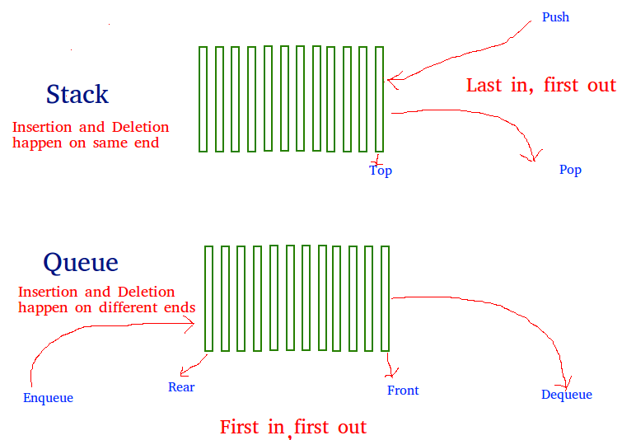
Stack vs Queue

Slide 12
Applications of Queues in cs
Operating system
Communication Software
Shared Printer

Slide 13

Basic operations of queue
Enqueue – insert at end
Dequeue – delete from front
Is_empty()
Is_full()
Front()

Slide 14
Implementation
Static
Queue is implemented by an array, and size of queue remains fix
Dynamic
A queue can be implemented as a linked list, and expand or shrink with each enqueue or dequeue operation.

Slide 15
Static queue Implementation
Front
When queue is empty both front and rear are set to -1
While enqueueing increment rear by 1, and while dequeueing increment front by 1
When there is only one value in the Queue, both rear and front have same index (0)
First Element
Second Element
.
.
Rear
Last Element
maxlength

Slide 16
implementation of Queues
public class Que //why class name is not queue
{
public :
int size; // default capacity
int *q; // array that holds queue elements
int front; // index of front of queue
int rear; // index of rear of queue

Slide 17
Constructor
Que() //default constructor
{
size = 10; //default size
q = new int[size]; // run time size allocation
front=-1; // initially front and rear are at -1
rear=-1;
}
Que(int x) //overloaded constructor
{
size = x; //user given size
q = new int[size]; // run time size allocation
front=-1; // initially front and rear are at -1
rear=-1;
}

Slide 18
Empty Operation
bool is_empty()
{
if (rear==-1)
return true;
else
return false;
}

Slide 19
Full Operation
bool is_full()
{
if (rear==SIZE-1)
return true;
else
return false ;
}
Void display()
{
if(is_empty()) { cout<<“\n Queue is empty….”; }
Else{
for(int i=front; i<=rear; i++)
{
cout<<“\n Value at index “<<i<< “ is: “<<q[i];

Slide 20
Enqueue Operation
void Enqueue(int x)
{
if (is_full())
{
cout<<“No space “;
}
else {
if(is_empty())
{
front=rear=0;
}
else{
rear++;
}
q[rear]=x;
}
}

Slide 21
Dequeue Operation
int Dequeue()
{
if (is_empty())
{
cout<<“Queue is already empty”;
return -1;
}
else
{
int x= q[front];
if(front==rear)
{
front=rear=-1;
}else{
front++;
}
return x;
}

Slide 22
Main method
Void main ()
{
Que q1; //Default constructor: object of que class with default size
Que q2(5); //Overloaded constructor: object of que class (q2) with size 5
Que q3(15);
q1.enqueue(5);
q2.enqueue(7);
q3.enqueue(6);
int x= q2.dequeue();
Cout<<“Dequeued element from q3 is: “<<x;

Slide 23
Shifting values/Quiz
4 | 5 | 7 | 2
0 | 1 | 2 | 3 | 4 | 5 | 6 | 7
Front=0 Rear = 3
5 | 7 | 2 | 2
0 | 1 | 2 | 3 | 4 | 5 | 6 | 7
After Dequeue();
Front=0 Rear = 2
Value at index 3 is now garbage as it is repeated, so after new equeue() new value will be at index 3. Hence value 2 at index 3 will be overwritten.

Slide 24
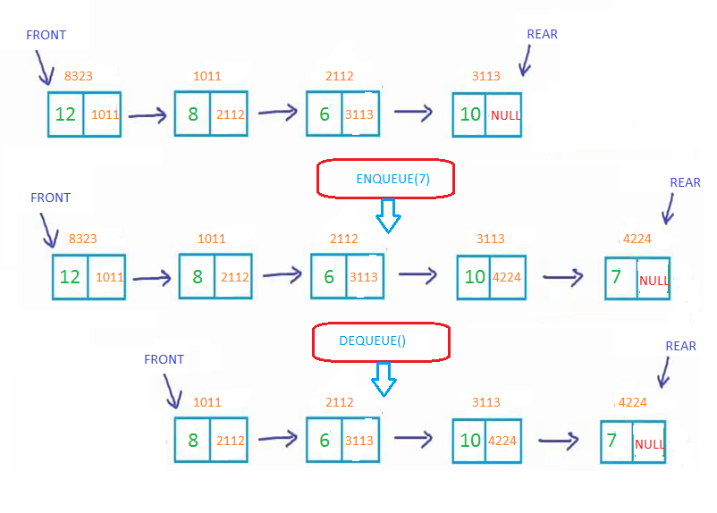
DYNAMIC QUEUE IMPLEMENTATION

Slide 25
Problems related to Array Implementation of Queues
Using array to implement queue introduces the possibility of overflow if the queue grows larger than the size of the array.
Now, we study other problems that arise in the linear implementation of queue.

Slide 26

Cont….
Elements |  |  |  | 7 | 5 | 2
Indexes | 0 | 1 | 2 | 3 | 4 | 5
Front = 3
Rear = 5
What if we call Enqueue (3)?
Queue is full
but the queue is not full
Question:
What to do now?
Notes:
In the figure on the previous slide , we have an interesting situation
Here q.front = 2 and q.rear = 4
So , 4 - 2 +1 =3 , elements in the queue
Queue has the room for five elements but we can’t insert new elements in the queue
Because to insert new element , q.rear must be incremented to 5 , which is outside the bounds of the array.

Slide 27
Solutions
Shift the elements while dequeuing
Not efficient solution
Implement by Circular Queue
Notes:
This method is too inefficient
Because if queue has thousands of elements , each deletion would involve moving all of them.
So , we should look for a more efficient implementation of queue.

Slide 28
Circular Queue

Slide 29
Circular Implementation
We can see that , in this implementation the first element immediately follows last element.
Even if the last element is occupied , we can insert new element in the first position, as long as the first element is empty.
In this implementation , we have an additional variable count , to keep track of the number of elements in the queue.

Slide 30
Solution: Using circular queue
If the queue is not full and rear is at size-1?
if(rear == queueSize-1)
rear = 0;
else
rear++;
Or use module arithmetic
rear = (rear + 1) % queueSize;

Slide 31
Example-1
When the queue is empty: front=rear=-1;
After enqueuer(8) front and rear will move to index 0.
front
Size - 1
rear
0
Move both front and rear at index 0.
6
8
1
5
2
4
3

Slide 32
Circular Array
To enqueue, advance the REAR pointer, and insert in its new position.
Now the rear was at index 3 and after enqueue(9) rear moved by
R=(r+1)%queue_size
so
R= (3+1)%8 = 4
Size - 1
0
6
1
front
4
1
5
2
9
7
4
3
rear

Slide 33
Circular Array
Consider this case:
Rear
Now the rear was at index 7 (size-1) and front is at index 3. If we enqueue(5) rear should move at index 0 by formula:
R=(r+1)% queue_size
so
R= (7+1)%8 = 0
Size - 1
0
6
1
1
4
2
5
2
9
7
4
3
front

Slide 34
Circular Array
Consider this case:
Rear
Rear
Now the rear was at index 7 (size-1) and front is at index 3. If we enqueue(5) rear should move at index 0 by formula:
R=(r+1)% queue_size
so
R= (7+1)%8 = 0
Size - 1
0
6
1
5
1
4
2
5
2
9
7
4
3
front

Slide 35
Circular Array
Advance the front to dequeue an item.
To dequeue the element, we move the front to new location by:
F=(f+1)%queue_size
so
F= (0+1)%8 = 1
Size - 1
0
front
6
2
1
4
1
5
2
7
4
3
Rear

Slide 36
Empty
In the case of a single item, the front and back point to the same index. So after deletion front and rear will have value -1.
Size - 1
0
6
1
5
2
9
4
3
front
Rear

Slide 37
Full CASE-1
Rear
front
Front = 0 and Rear = size-1
Size - 1
0
6
9
2
1
7
4
4
6
5
2
5
7
4
3

Slide 38
FULL CASE-2
Size - 1
0
if(Rear+1)%queue_size = = front
count = size;
6
1
7
1
4
4
Full !!
2
3
5
2
9
7
front
4
3
Rear

Slide 39
Example-2
ENQUEUE OPERATION
0 1 2 3 4 5 6 7 8
Front= -1
Rear= -1
Enqueue 9 As the queue is empty so we move front and rear to 0
9
0 1 2 3 4 5 6 7 8
Front=0
Rear=0
Enqueue 3 Rear=(Rear+1) mod Queue Size = (0+1) mod 9 = 1
9
3
0 1 2 3 4 5 6 7 8
Front=0
Rear=1

Slide 40
ENQUEUE OPERATION
9
5
1
6
0 1 2 3 4 5 6 7 8
Front=5
Rear=8
Enqueue 4 Rear=(Rear+1) mod Queue Size = (8+1) mod 9 = 0
4
9
5
1
6
0 1 2 3 4 5 6 7 8
Front=5
Rear=0
Enqueue 0 Rear=(Rear+1) mod Queue Size = (0+1) mod 9 = 1
4
0
9
5
1
6
0 1 2 3 4 5 6 7 8
Front=5
Rear=1

Slide 41
Queue Full
Enqueue 8 Rear=(Rear+1) mod Queue Size = (4+1) mod 9 = 5
3
4
2
3
9
7
6
5
1
0 1 2 3 4 5 6 7 8
Front=5
Rear=4
if(rear+1%queue_size==front) – FULL
(4+1)%9 = = 5

Slide 42
DEQueue operation
7
6
5
1
0 1 2 3 4 5 6 7 8
Front=5
Rear=8
Dequeue() Front=(Front+1) mod Queue Size = (5+1) mod 9 = 6
6
5
1
0 1 2 3 4 5 6 7 8
Front=6
Rear=8

Slide 43
DEQueue operation
3
4
1
0 1 2 3 4 5 6 7 8
Front=8
Rear=1
Dequeue() Front=Front+1) mod Queue Size = (8+1) mod 9 = 0
3
4
0 1 2 3 4 5 6 7 8
Front=0
Rear=1

Slide 44
DEQueue operation
1
0 1 2 3 4 5 6 7 8
Front=8
Rear=8
Dequeue() Front= = Rear
0 1 2 3 4 5 6 7 8
Front= -1
Rear= -1
QUEUE BECOMES EMPTY

Slide 45
void Equeue(int x )
{
if(Is_full())
{
cout<<“Queue is already full”;
}
else{
if(IsEmpty())
{
front=rear=0;
}
else
{
Rear=(Rear+1) % QueueSize;
}
que[rear]=x;
}

Slide 46
int Dequeue( )
{
if (IsEmpty())
{
cout<<“Underflow”;
return -1;
}
else
{
int ReturnValue=Data[Front];
if (Front==Rear) //only one element in the queue
Front=Rear=-1;
else
Front=(Front+1) % QueueSize;
return ReturnValue;
}
}

Slide 47
bool IsEmpty()
{
if (Front==-1)
return true;
else return false;
}
bool IsFull()
{
if (((Rear+1)%QueueSize)==Front)
return true;
else return false;
}

Slide 48
Double Ended Queue (Deque)
It is also a homogeneous list of elements in which insertion and deletion operations are performed from both the ends.
That is, we can insert elements from the rear end or from the front ends.
Hence it is called double-ended queue. It is commonly referred as a Deque.
There are two types of Deque. These two types are due to the restrictions put to perform either the insertions or deletions only at one end.

Slide 49
Deques
A deque is a double-ended queue
Insertions and deletions can occur at either end
Implementation is similar to that for queues
Deques are not heavily used

Slide 50
ADT Deque
Need for an ADT which offers
Add, remove, retrieve
At both front and back of a queue
Double ended queue
Called a deque
Pronounced “deck”
Actually behaves more like a combination of Stack and Queue

Slide 51
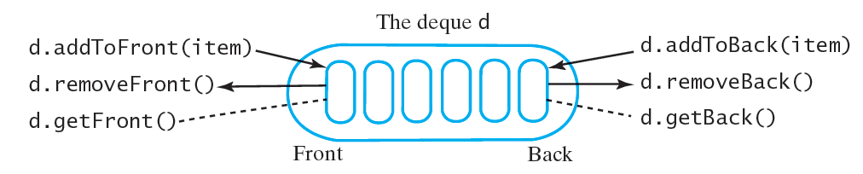
ADT Deque

Slide 52
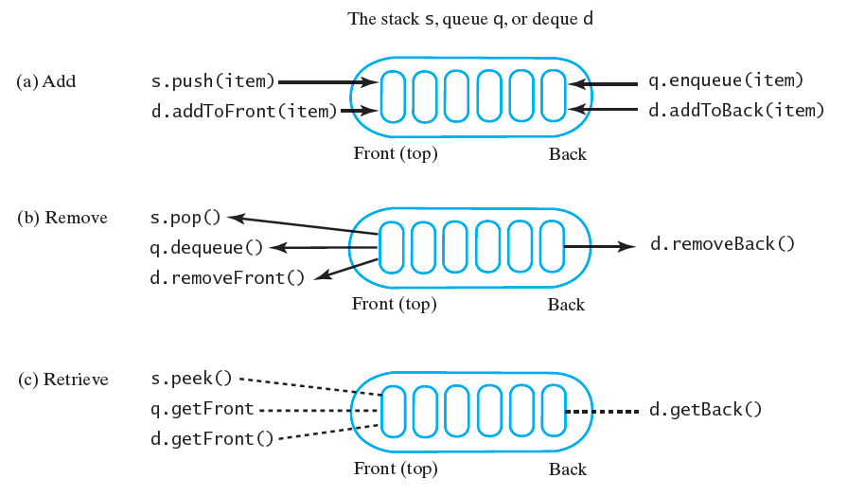

Slide 53
Double-Ended Queues (deque)( "D.Q.")
Supports insertion and deletion at both the front and the rear of the queue.
The Deque Abstract Data Type
addFirst(e): Insert a new element e at the beginning of the deque.
addLast(e): Insert a new element e at the end of the deque.
removeFirst(): Remove and return the first element of the deque; an error occurs if the deque is empty.
removeLast(): Remove and return the last element of the deque; an error occurs if the deque is empty.
getFirst(): Return the first element of the deque; an error occurs if the deque is empty.
getLast(): Return the last element of the deque; an error occurs if the deque is empty.
size(): Return the number of elements of the deque.
isEmpty(): Determine if the deque is empty.

Slide 54
Double-Ended Queues (cont.)
Operation Output D
addFirst(3) - (3)
addFirst(5) - (5,3)
removeFirst() 5 (3)
addLast(7) - (3,7)
removeFirst() 3 (7)
removeLast() 7 ()
removeFirst() "error" ()
isEmpty() true ()

Slide 55
Implementing a Deque
Doubly linked list:
Since the deque requires insertion and removal at both ends of a list, using a singly linked list to implement a deque would be inefficient.
Method Time
size, isEmpty O(1)
getFirst, getLast O(1)
add First, addLast O(1)
removeFirst, removeLast O(1)

Slide 56
Double Ended Queue (Deque)
There are:
Input-restricted Deque.
Output-restricted Deque.
Bellow show a figure a empty Deque Q[5] which can accommodate five elements.
deletion
insertion
insertion
deletion
Q[0]
Q[1]
Q[2]
Q[3]
Q[4]
Fig: A Deque

Slide 57
Double Ended Queue (Deque)
There are:
Input-restricted Deque: An input restricted Deque restricts the insertion of the elements at one end only, the deletion of elements can be done at both the end of a queue.
deletion
10 | 20 | 30 | 40 | 50
insertion
deletion
Q[0]
Q[1]
Q[2]
Q[3]
Q[4]
Fig: A representation of an input-restricted Deque

Slide 58
Double Ended Queue (Deque)
There are:
Output-restricted Deque: on the contrary, an Output-restricted Deque, restricts the deletion of elements at one end only, and allows insertion to be done at both the ends of a Deque.
insertion
10 | 20 | 30 | 40 | 50
insertion
deletion
Q[0]
Q[1]
Q[2]
Q[3]
Q[4]
Fig: A representation of an Output-restricted Deque

Slide 59
Priority Queue
A priority queue is a collection of elements where the elements are stored according to their priority levels.
The order in which the elements should get added or removed is decided by the priority or the element.
Following rules are applied to maintain a priority queue.
The element with a higher priority is processes before any element of lower priority.

Slide 60
Priority Queue
If there are elements with same priority, then the element added first in the queue would get processed
Here, smallest number that is most highest priority and greater number that is less priority.
Priority queues are used for implementing job scheduling by the operating system.
Where jobs with higher priorities are to be processed first.
Another application of priority queue is simulation systems where priority corresponds to event times.

Slide 61
Priority queue
A stack is first in, last out
A queue is first in, first out
A priority queue is least-first-out
The “smallest” element is the first one removed
(You could also define a largest-first-out priority queue)
This means that in general the Priority Queue can be called as Highest-Priority-Out
Contrast bank queue and emergency room queue(s)
If there are several “smallest” elements, the implementer must decide which to remove first
Remove any “smallest” element (don’t care which)
Remove the first one added

Slide 62
class PriorityQApp
{
void main( )
{
PriorityQ thePQ = new PriorityQ(5);
thePQ.insert(30);
thePQ.insert(50);
thePQ.insert(10);
thePQ.insert(40);
thePQ.insert(20);
while( !thePQ.isEmpty() )
{
long item = thePQ.remove();
cout<<item<<“ “; // 10, 20, 30, 40, 50 Note: ORDERED!
} // end while
} // end main()
//-------------------------------------------------------------
} // end class PriorityQApp
62

Slide 63
Array implementations
A priority queue could be implemented as an unsorted array (with a count of elements)
Adding an element would take O(1) time (why?)
Removing an element would take O(n) time (why?)
Hence, adding and removing an element takes O(n) time
This is an inefficient representation
A priority queue could be implemented as a sorted array (again, with a count of elements)
Adding an element would take O(n) time (why?)
Removing an element would take O(1) time (why?)
Hence, adding and removing an element takes O(n) time
Again, this is inefficient

Slide 64
Linked list implementations
A priority queue could be implemented as an unsorted linked list
Adding an element would take O(1) time (why?)
Removing an element would take O(n) time (why?)
A priority queue could be implemented as a sorted linked list
Adding an element would take O(n) time (why?)
Removing an element would take O(1) time (why?)
As with array representations, adding and removing an element takes O(n) time
Again, these are inefficient implementations
Efficient implementations of priority queues can be done using balanced binary tree implementations …… we will see in the coming lectures.

Slide 65
References
Dr. Yasir Faheem, COMSATS University, Islamabad
C++ plus data structures / Nell Dale
Data Structures and Algorithms in C++, Second Edition by Adam Drozdek
https://www.geeksforgeeks.org/

Slide 66


